Slide 1
June 2, 2026 – 1:30 to 3:00 PM
Family Reunification
Leveraging Tools and Partnerships
for Success

Slide 2
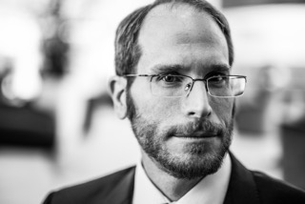
Eric Alberts
Central Florida Disaster Medical Coalition Board Chair
Assistant Vice President, Emergency Management, Orlando Health
RDSTF Health & Medical Co-Chair
2
Notes:
Eric will go first – 30 minutes

Slide 3
Today’s learnings:
Why FRC Plans Are Important
Tangible Takeaway: the Toolkit
Hospitals Must Be Prepared
Counties Must be Prepared
Partnerships are Vital
American Red Cross Overview
1
3

Slide 4

From Pulse
to the Toolkit
The CFDMC FRC/FAC Toolkit can be found at:
https://www.centralfladisaster.org/_files/ugd/8d7960_5717ff85c7dd432cb46a1ab7a497e716.pdf
1
3

Slide 5
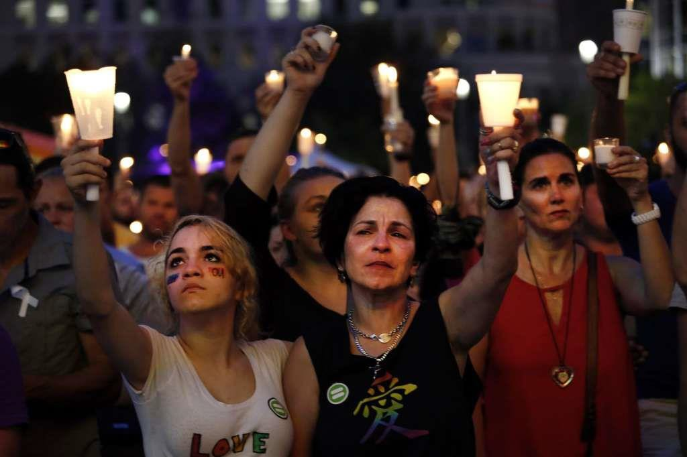
Why are Family Reunification
Plans Important?
Pulse Nightclub Shooting – June 2016
At the time, the deadliest mass shooting in
US history
40 deceased at scene
56 victims (44 to closest trauma center; 12 to local hospitals)
6,000 calls on Day 1
By Day 2, the FRC/FAC had assisted 1,240 family members
Before closing, thousands were served at the FRC/FAC
3
Notes:
In Pulse, the initial family reunification center was set up at a hotel across the street from the trauma center. Within a day, a Family Assistance Center was opened at a nearby senior center. By Day 4, the numbers had increased to the point where the City moved this to Camping World Stadium, with 26 service providers assisting families. The FAC remained open for weeks.
Advance planning for family reunification is the key to success; otherwise local jurisdictions may quickly be overwhelmed in dealing with family members
While numbers may vary based on the incident, the best practice guidance is to plan for a ratio of 10 family members per victim. In incidents involving children, the ratio may be even higher due to the vulnerability of children and the need to reunite them with custodial caregivers as quickly as possible
I think all involved in emergency management have accepted the new normal – it’s not a matter of if, it is a matter of when. When a mass casualty occurs, an FRC plan is crucial.

Slide 6

County Template
Metro Orlando FAC Working Group Mission: Create a comprehensive FRC plan template
Facilitated by City of Orlando Emergency Management with multiple partners (hospitals, emergency management, EMS, CFDMC, medical examiners, schools/universities, social services, local/state/federal law enforcement, the American Red Cross, etc.
The FRC/FAC plan template was published in December 2017 and shared with all county emergency management offices and healthcare coalitions in Florida
Our counties were making great progress and then COVID hit and FRC planning was delayed
Metro Orlando Family Assistance Center Workgroup
The EOC plan is the first tool in the
CFDMC Toolkit
4
Notes:
The first tool in the toolkit is a template which can be used by county or local jurisdictions to develop their plan. The template contains:
Section 1 is a planning guideline, including purpose, scope, authorities, planning considerations and assumptions, plan development and maintenance, and training and exercises
Section 2 includes position checklists
Section 3 includes references, organizational charts, and sample layouts and forms
Section 4 includes information for jurisdictional appendices such as potential locations, participating agencies, equipment checklists, inventory, call center procedures and sample MOUs/MOAs
Eric – one note – patient tracking is still a problem in many jurisdictions. We are actively working to implement Pulsara across Region 5. This will aid family reunification efforts.

Slide 7
Rapid Response Team
CFDMC used the base plan to develop a rapid response team
Rapid response team is an asset that local jurisdictions can request to immediately set-up FRC/FAC and operate until the local jurisdiction can take over
Started with a small group of leaders with extensive FRC/FAC experience
Exercised at Daytona International Airport Exercise in March 2022
Lessons learned from November 2024 request highlighted need to simplify the plan and recruit/train new team members
The Response Team Plan is the second tool|
in the CFDMC FRC/FAC Toolkit
3
Notes:
The team can be deployed upon request to quickly open an FRC/FAC, and help the jurisdiction until they can take over
The team exercised in 2022 at the Daytona International Airport. In an airline crash, the airline is responsible for the FRC/FAC, but it typically takes 8 to 12 hours for the airline to get this operational. The response team worked with the airport to set up a family reunification center. Lessons learned were simplifying the intake form, capturing a description of the survivor, assigning someone to ask questions and complete the form for the family/friends, ensuring there is a separate staging area for the media away from the FRC, and the need for security at the FRC.
The team was requested following a tornado outbreak in November 2024. While we were trying to roster the team, the mission was cancelled. However, we realized that many of our experienced leaders had retired. We are in the process of simplifying the rapid response plan, and recruiting/training new team members.
A valuable resource in setting up a team like this is the Florida Crisis Response Team. Many of their team leaders have responded to FRCs/FACs across the nation, including Pulse, Sandy Hook, Los Vegan, Uvalde, and many others
The rapid response team is the second tool n the toolkit

Slide 8
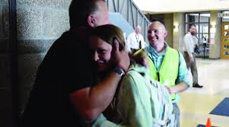
Hospital Plan Template
Hospitals will be immediately mobbed with family and friends
Hospitals must have plans to handle the immediate influx of family and friends seeking loved ones until a county FRC/FAC can be opened
Template provides a hospital checklist in building a plan
Developed and exercised by Orlando Health, Inc.
The Hospital Template is the third tool|
in the CFDMC FRC/FAC Toolkit
4
Notes:
Eric – you led this effort so you can speak to how important this is to hospitals and how the template can be used

Slide 9
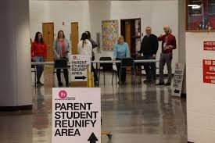
School Plan Template
CFDMC and Orlando Health worked with partners to develop a school plan template
School shootings continue. Bus accidents occur
Schools must be ready to reunify children with their families
The school template provides school districts with a checklist for developing a school-based plan
The School Template is the fourth tool|
in the CFDMC FRC/FAC Toolkit
3

Slide 10
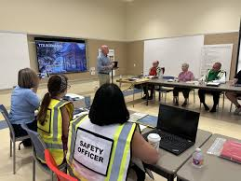
Tabletop Template
Ready to get started? A tabletop is a great way to bring all the partners together
CFDMC developed an FRC/FAC tabletop and held a tabletop design review meeting with partners in May 2023 to vet the tabletop materials
CFDMC will facilitate a tabletop in any of our region’s counties upon request
The toolkit tabletop materials in the toolkit can be customized to your jurisdiction, your scenario, etc.
The FRC Tabletop is the fifth tool
in the CFDMC FRC/FAC Toolkit
4

Slide 11

Notes:
Eric will pass the presentation to Sandy Lanier

Slide 12

Sandy Lanier
Emergency Management Specialist
Orange County Office of Emergency Management
2

Slide 13
Using the Toolkit to Develop a County Plan
1
3

Slide 14
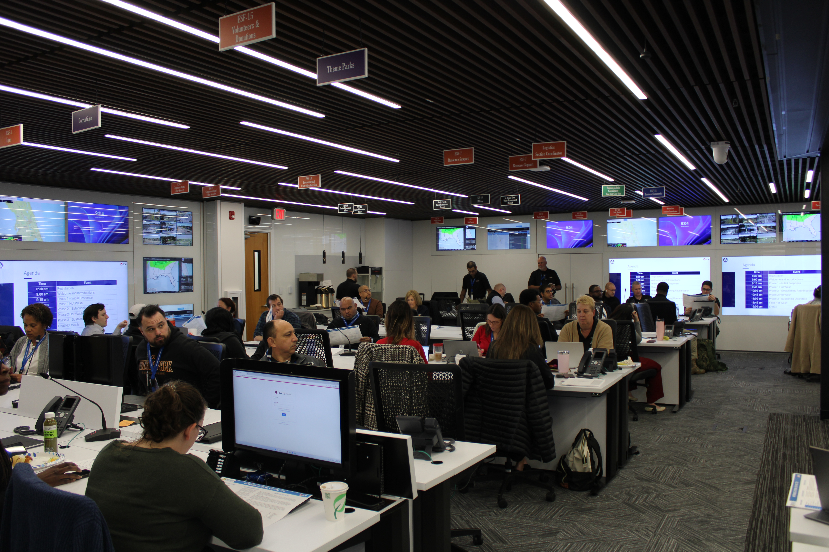
Orange County FRC/FAC Plan
Identified family reunification planning as a county priority
Convened stakeholder kickoff meeting
Defined Partner roles and points of contact
Adapted toolkit template for county operations
Distributed draft plan for stakeholder review
Tabletop exercise February 2026
Next Steps:
  Finalize Plan
  Validate through exercise
  Continue partner coordination
Notes:
Sandy Lanier – 10 to 15 minutes
Sandy will describe why this is important to Orange County EM, and the process they are using to develop the plan

Slide 15
Notes:
Eric will thank Sandy and transition to Christine Mouton

Slide 16
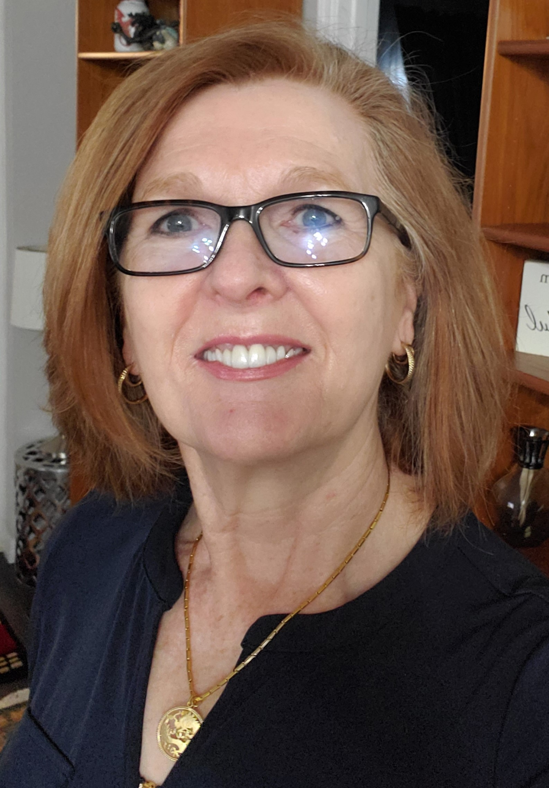
Christine Mouton
Florida Crisis Response Team Regional Coordinator
Retired Director of the UCF
Victim Services Program
2

Slide 17
The Power of Partnerships
1
3

Slide 18
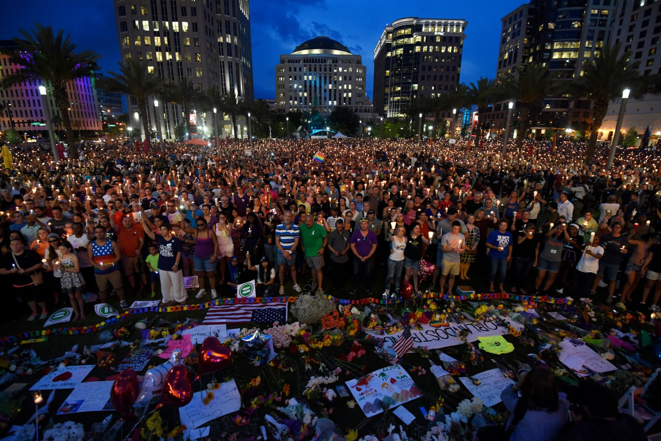
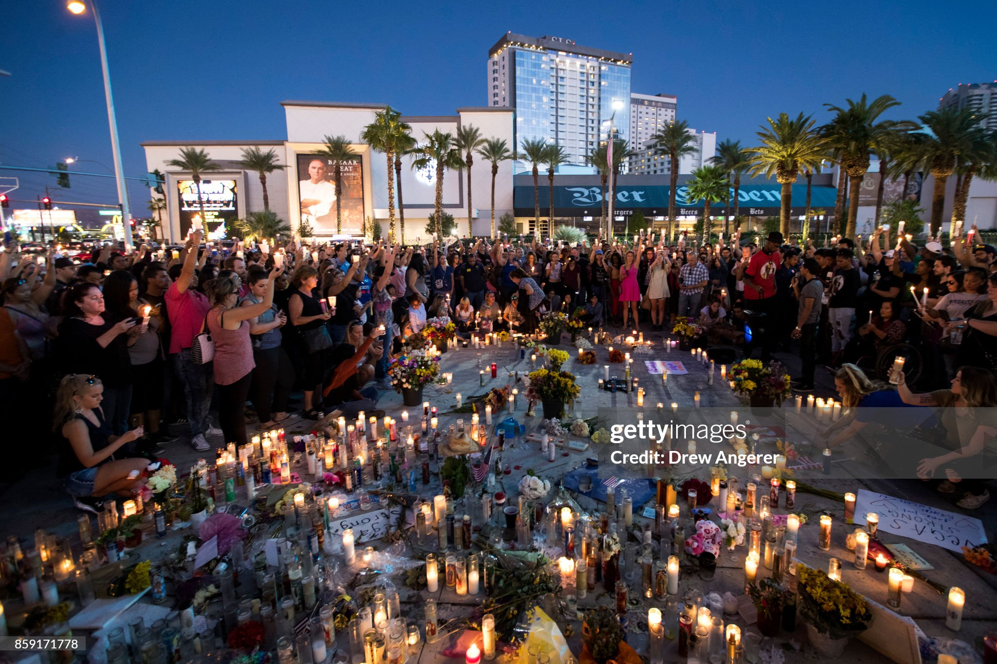
Leveraging Partnerships
Florida Crisis Response Team
  Affiliate of the National Organization for Victim Assistance (NOVA)
Federal/State/Local Law Enforcement
  Safety and Security
Victim Advocates
  Criminal Justice System
  Non-Profit
  Community Programs
Schools/Universities
  Resources
  Support
Pulse Memorial 2016
Las Vegas Memorial 2017
3
Notes:
Christine Mouton – 10 to 15 minutes
Focus on how to use partners and which partners are the most valuable in an FRC/FAC. Emphasize FCRT as a resource
Share any lessons learned from your experience at FRC/FACs across the nation
Photo?

Slide 20
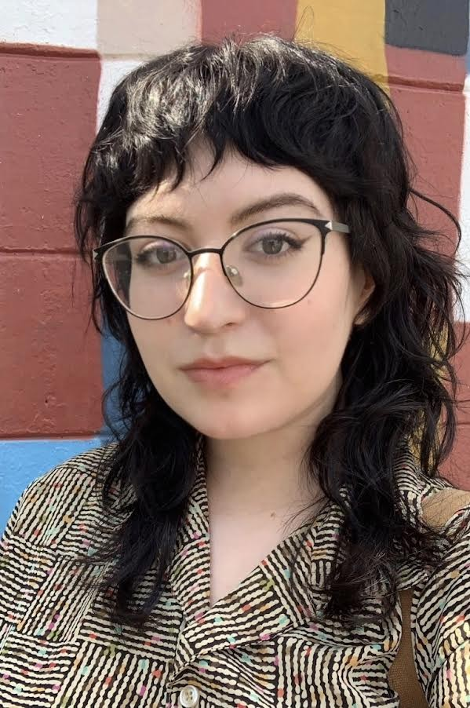
American Red Cross
Shannon Hagan
Division Disaster Director
State of Florida and FEMA Region IV
2
Notes:
ARC – 30 minutes

Slide 21
Red Cross Reunification Services
Under the National Response Framework, FEMA and the American Red Cross are co-leads for Reunification
The American Red Cross performs Reunification services for events ranging from a multi-family apartment complex fire to a mass casualty incident
Seekers can submit a Reunification Request Form at redcross.org/find or by calling 1-800-RED-CROSS
  Replaces the Safe and Well system
Regional mass care and reunification personnel handle day-to-day reunification requests
3

Slide 22
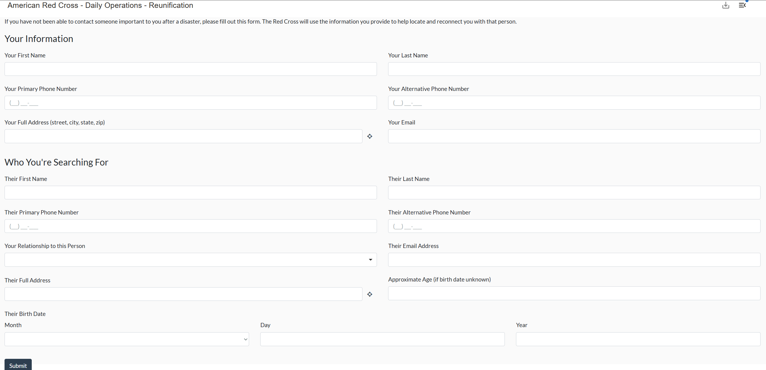
redcross.org/find
3

Slide 23
Reunification Process
The Seeker and the Sought are both considered clients in our system
One a request comes in:
  Contact Seeker to get a better understanding of the reunification request
  Ask questions about the Sought (last contact, frequent locations, etc.)
  Check known databases (internal and external)
  Confer with government partners (law enforcement, case managers, etc.)
  Follow up on any leads, meet with neighbors/employers
  Update the Seeker with any information
3

Slide 24
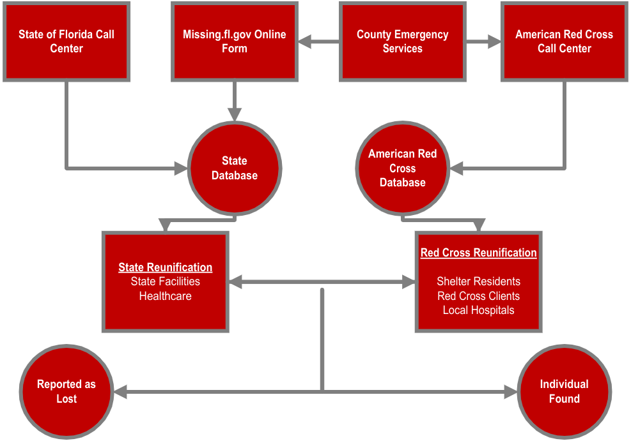
Real World Example – Hurricane Ian
3

Slide 25
Incorporating Existing Systems
Reunification does not replace the safety systems in place for missing persons. Any process must incorporate the relevant partners:
  Local Law Enforcement
  National Center for Missing and Exploited Children
  National Trafficking Resource Center
  Immigration and Customs (for Human Trafficking concerns)
  Disaster Mental Health
3

Slide 26
Mass Casualty Incidents
Following an MCI, the American Red Cross works directly with government partners to identify and support pre-existing reunification plans or post-incident strategies
The American Red Cross may establish unique incident-specific URLs to route reunification requests through
Client Navigators may support Family Reunification Centers or Family Assistance Centers
Referrals to Disaster Mental Health and Emotional/Spiritual Care resources
3

Slide 27
Restoring Family Links
Began in 1859
Outlined in the Geneva Convention
Comprised of the International Committee of the Red Cross (ICRC), the International Federation of Red Cross and Red Crescent Societies, and 191 National Red Cross and Red Crescent Societies
Coordinated effort to help people who have lost contact with their family as a result of a conflict, a natural disaster, or migration
3

Slide 29
Tangible Takeaway
CFDMC FRC-FAC Toolkit
https://www.centralfladisaster.org/_files/ugd/8d7960_5717ff85c7dd432cb46a1ab7a497e716.pdf
Notes:
Eric – the toolkit is on the COALITION WEBSITE – SEE LINK

Slide 30
Notes:
Eric – ask for any final questions

