Slide 1
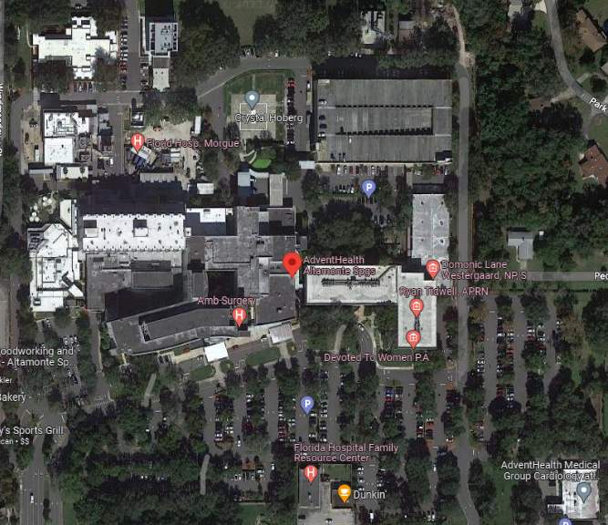
AdventHealth Altamonte Springs
601 East Altamonte Drive, Altamonte Springs
Decon ops: east of parking garage
Decon/Med Surge Conex: west side of parking garage
Staging area: southeast parking lot
Other Locations:
Victim Discharge Area: Cafe
HCC: Executive Conference Room
Labor Pool: TBD on exercise day
Fatality Management: ED radiology area
Victim-designated bathroom: 1st floor MOB with a mask and escort
Key Phone Numbers:
Exercise Lead: Justin Everhardt 813-7190-0006
Lead Controller: Sarah Cabrera 407-702-0597
Asst Controller: Gwendolyn Viccaro 407-615-0224
HCC: 407.644.4032

Slide 2
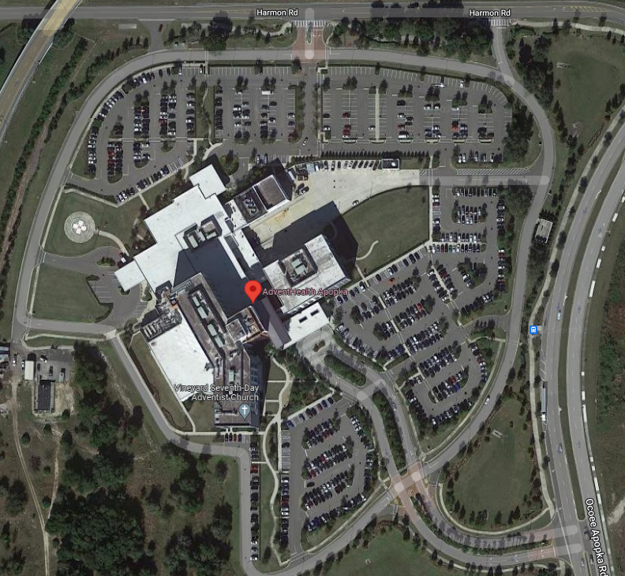
AdventHealth Apopka
2100 Ocoee Apopka Rd, Apopka
Decon ops: EMS ramp into ED
Decon & Med Surge Conex: EMS ED entrance
Staging area: access road near Fire Station
Other Locations:
Victim Discharge Area: 1st floor conference room
HCC: Apopka Boardroom
Labor Pool: Conference Room A
Fatality Management: TBD by HCC
Victim-designated bathroom: bathroom near Engineering
Key Phone Numbers:
Exercise Lead: Justin Everhardt 813-7190-0006
Lead Controller: Ted Burgwald 352-630-0044
Asst Controller: Bobby Mladenov 239-580-7924
HCC: 407-884-1318

Slide 3
AdventHealth Celebration
400 Celebration Pl, Celebration
Decon ops: NW of ED
Decon & Med Surge Conex: generator plant
Staging area: : door outside Palms Conference room- Call
Key Phone Numbers:
Exercise Lead: Justin Everhardt 813-719-0006
Lead Controller: Erik Nielsen 407-947-1006
Asst Controller:
HCC: 321.939.2283
Other Locations:
Victim Discharge Area: Palms Conference Room
HCC: Executive Boardroom
Labor Pool: area outside of Exec Boardroom
Fatality Management: TBD by HCC
Victim-designated bathroom: Central Energy Plant

Slide 4
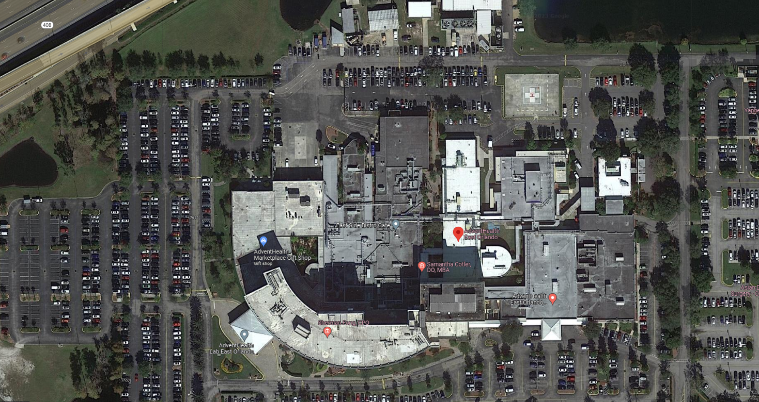
AdventHealth East Orlando: 7727 Lake Underhill Rd, Orlando
Decon ops: east of ED and Doc Parking
Decon & Med Surge Conex: generator plant & ambo bay
Staging area: Back parking area near physician parking
Key Phone Numbers:
Exercise Lead: Justin Everhardt 813-719-0006
Lead Controller: Lily Nguyen 407-408-3366
Asst Controller: Samuel Cartagena 407-807-1746
Asst Controller:
Other Locations:
Victim Discharge Area: Precedo B
HCC: Precedo A
Labor Pool: Precedo E
Fatality Management: TBD by HCC
Victim-designated bathroom: bathroom located near Cafeteria
HCC: 407-381-3958

Slide 5
AdventHealth Kissimmee
2450 N Orange Blossom Trail, Kissimmee (bus parking at 201 Hilda St)
Decon ops: between ED & tennis courts
Decon & Med Surge Conex: by engineering shed
Staging area: Hilda St MOB, 201 Hilda St.
Other Locations:
Victim Discharge Area: Woodlands A-C
HCC: Executive Conference Room
Labor Pool: TBD by HCC
Fatality Management: TBD by HCC
Victim-designated bathroom: Hilda St. MOB
Key Phone Numbers:
Exercise Lead: Justin Everhardt 813-719-0006
Lead Controller: Art Aza 407-509-9962
Asst Controller: Mark Albright 321.217.9948
HCC: 407-931-1335

Slide 6
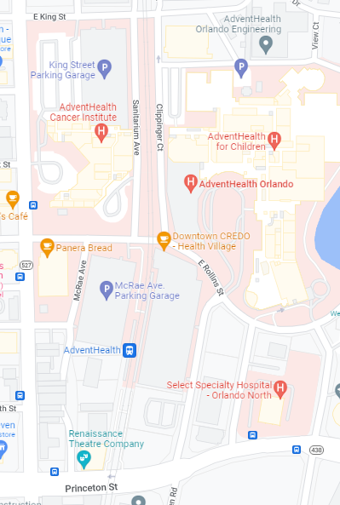
AdventHealth Orlando
601 E. Rollins St, Orlando
Decon ops: Creation Lawn
Decon & Med Surge Conex: Hazwaste area
Victim staging area: KidsDoc Building: 615 East Princeton St, Orlando, Fl 32803
Other Locations:
Victim Discharge Area: Creation Auditorium
HCC: CVI Boardroom, 1st floor
Labor Pool: Creation Conference Room
Fatality Management: Obs unit
Victim-designated bathroom: Kids Doc lobby with escort
Key Phone Numbers:
Exercise Lead: Justin Everhardt 813-719-0006
Lead Controller: Justin Everhardt 813-719-0006
Asst Controller: Michael Ploeckelmann 407-779-0757
Asst Controller: Elissa Mackintosh 407-415-0541 HCC: 407-303-0369

Slide 7
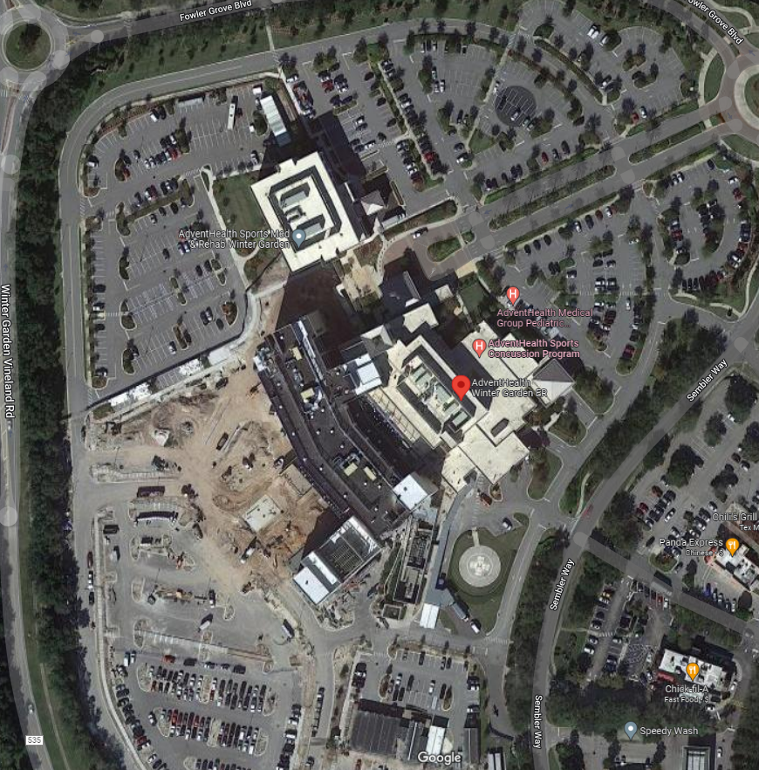
AdventHealth Winter Garden
2000 Fowler Grove Blvd, Winter Garden
Decon ops: SE side of building near ambo bay
Decon & Med Surge Conex: ambulance bay
Staging area: SW parking area past loading dock- victim holding in discharge area as needed
Other Locations:
Victim Discharge Area: main ground conference A and B
HCC: Executive Boardroom
Labor Pool: HCC (Executive Board Room)
Fatality Management: ED Storage Room
Victim-designated bathroom: loading dock area with escort
Key Phone Numbers:
Exercise Lead: Justin Everhardt 813-719-0006
Lead Controller: Angie McDonald 480-226-7599
Asst Controller: Ron Raymond 603-365-6148
HCC: 407-884-1318

Slide 8
AdventHealth Winter Park
200 N Lakemont Ave, Winter Park
Decon operations: Lakemont Ave/ loading dock area
Decon & Med Surge Conex: behind engineering
Staging area: 2nd floor. EMS and LE parking in MOB parking lot
Other Locations:
Victim Discharge Area: old ED observation area
HCC: Miller Conference Room
Labor Pool: WP Conference Center
Fatality Management: old ED area
Key Phone Numbers:
Exercise Lead: Justin Everhardt 813-719-0006
Lead Controller: Crystal Young 321-230-6505
Asst Controller: Brenna Young 5712752751
HCC: 407-647-5803

