Slide 1
Climate Change
And Its Effects
Your Organizaton’s Name
Resource Provided by Orlando Health

Slide 2
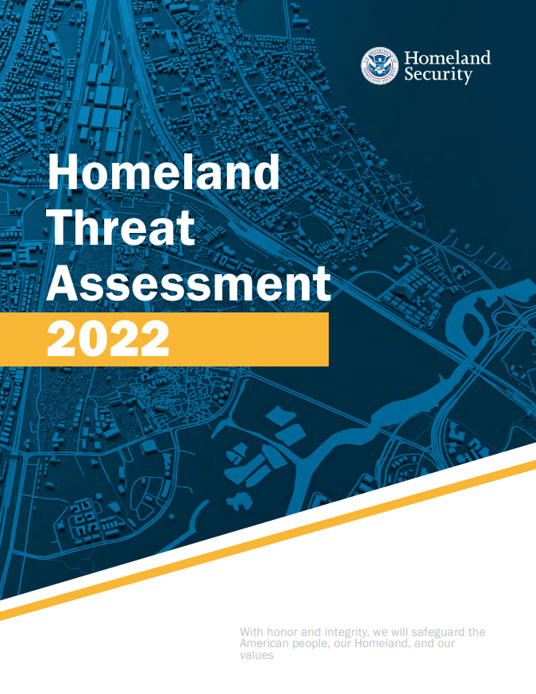
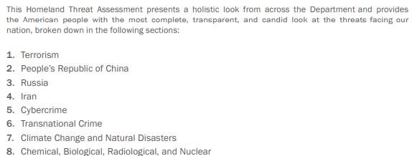
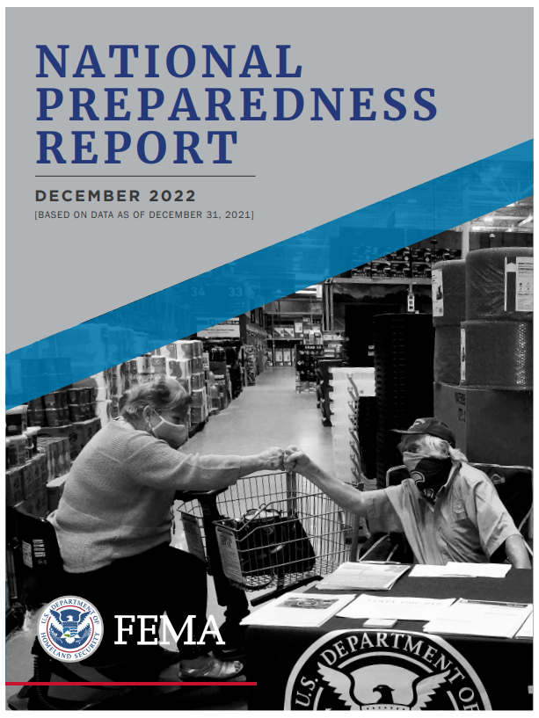
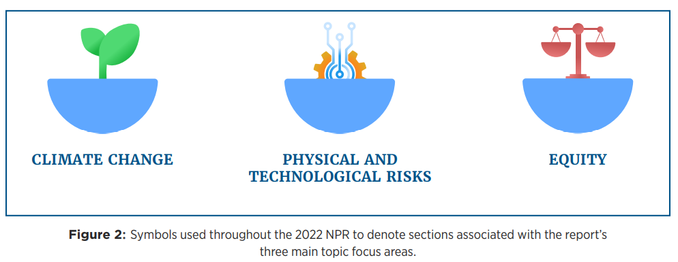

Slide 3
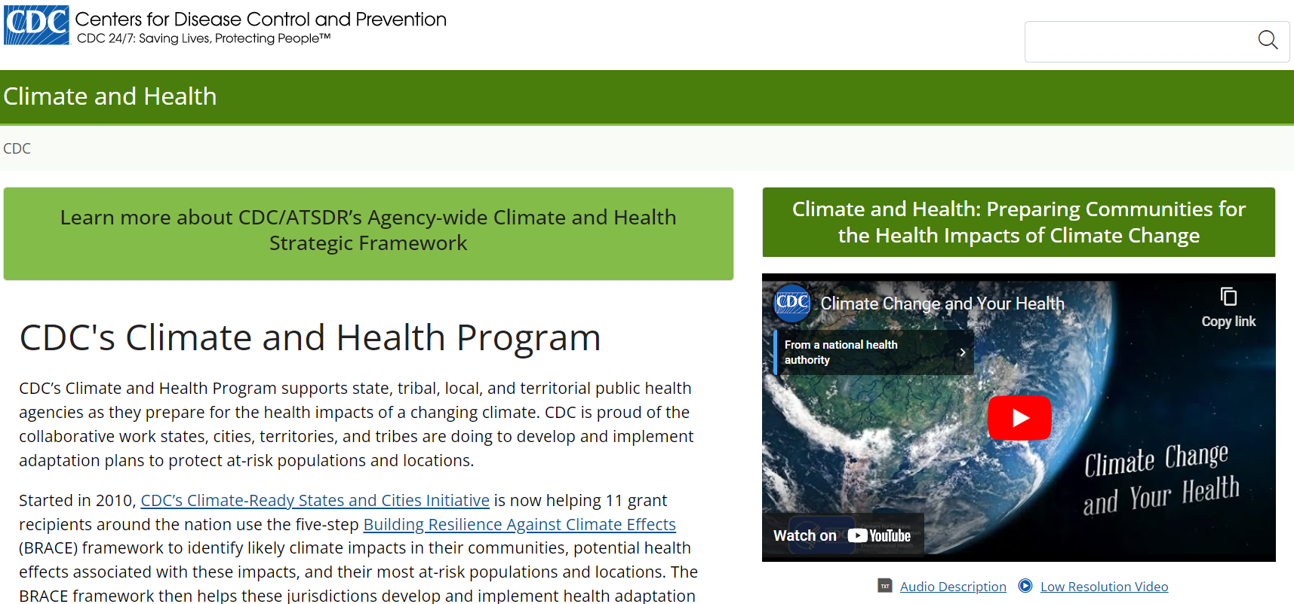

Slide 4
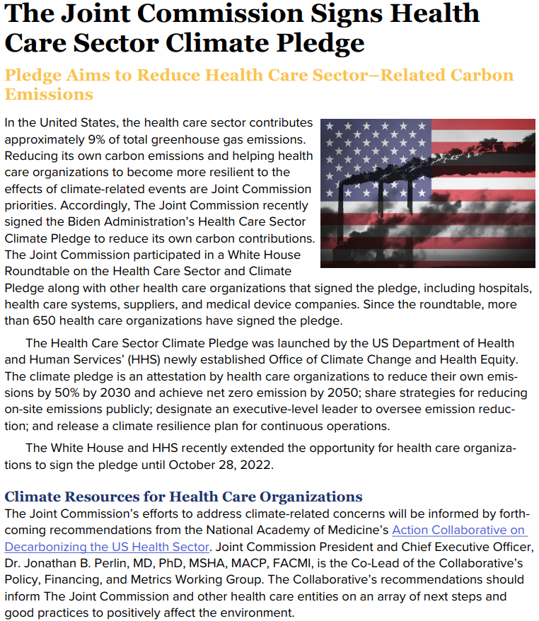
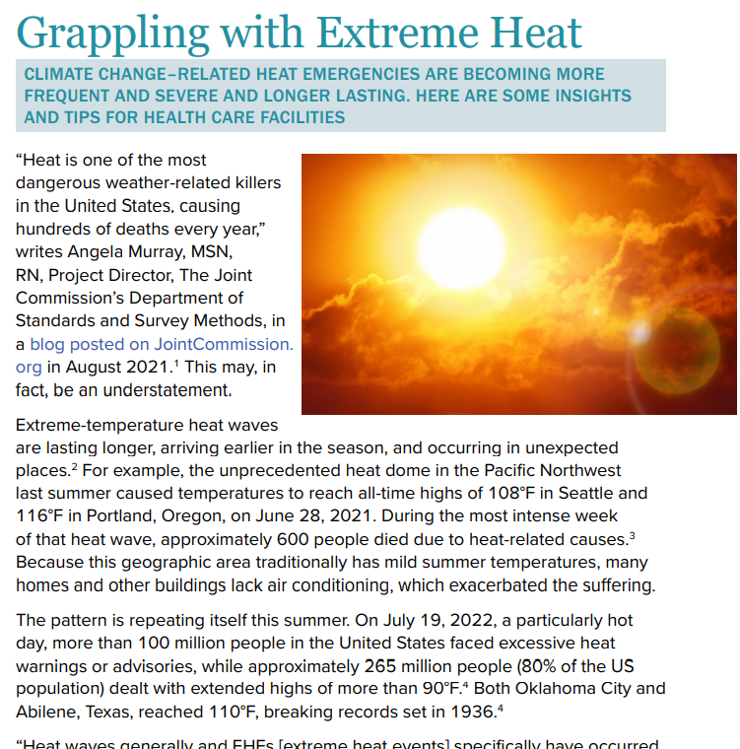

Slide 5
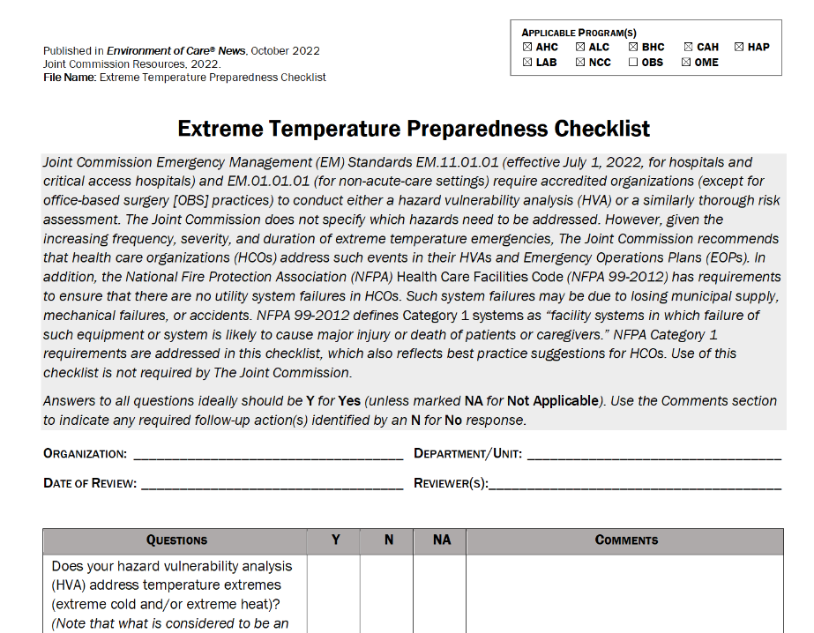
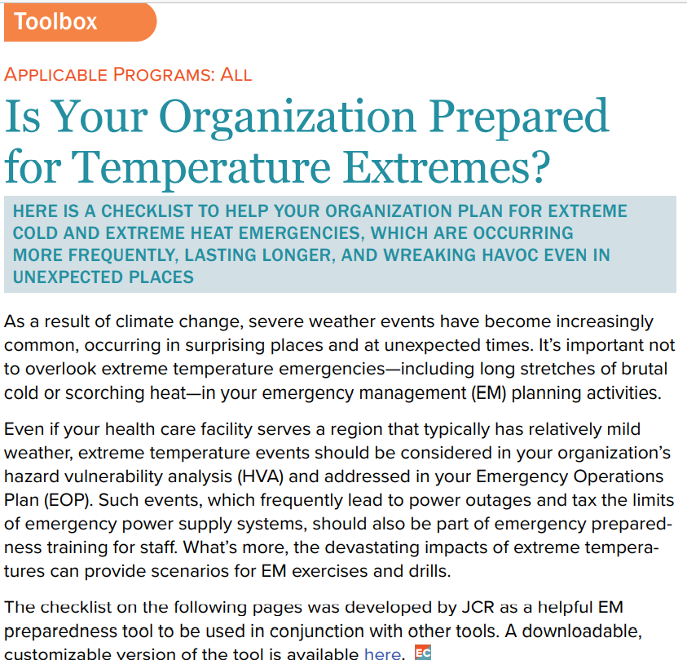

Slide 6
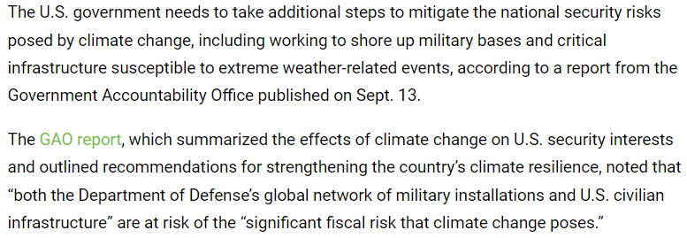

Slide 7
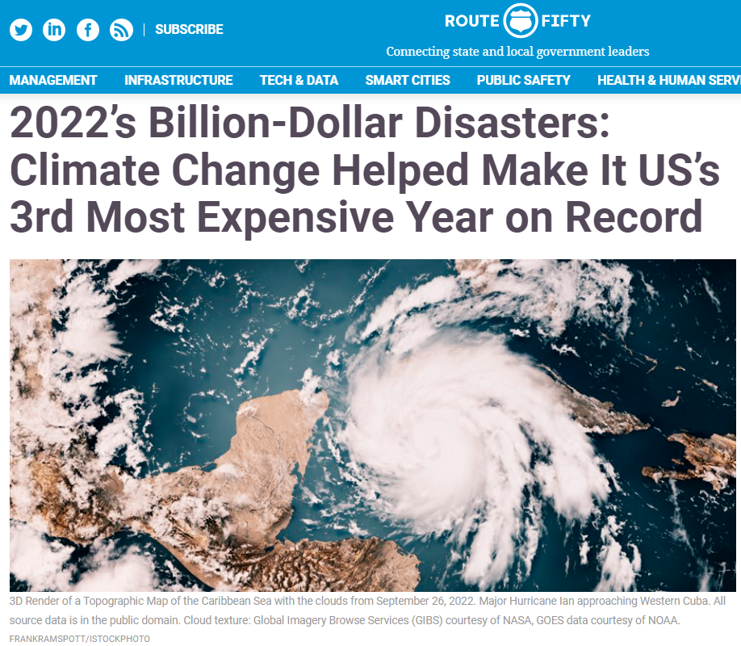
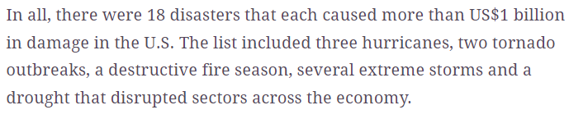
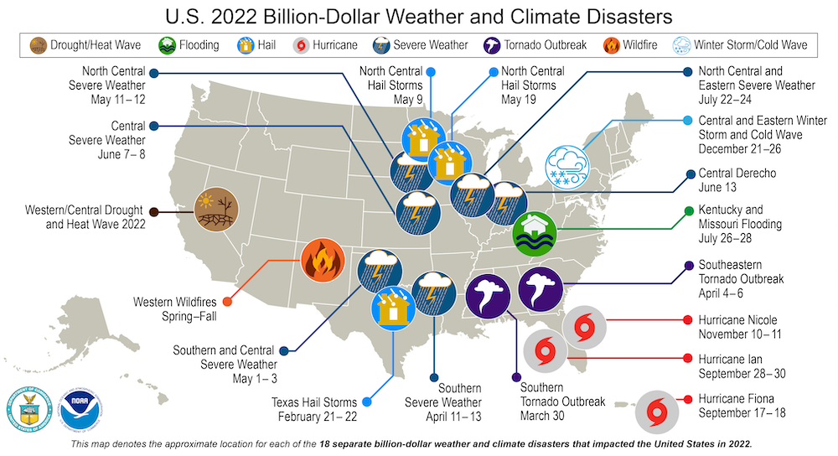

Slide 8
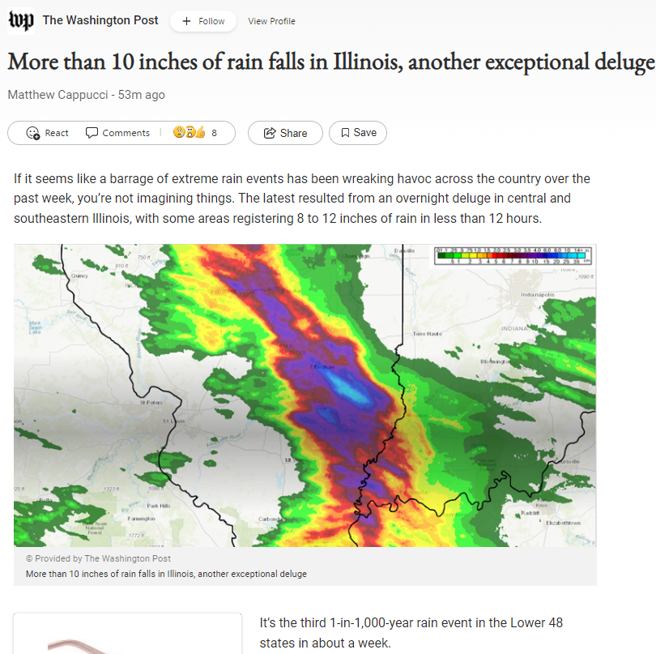
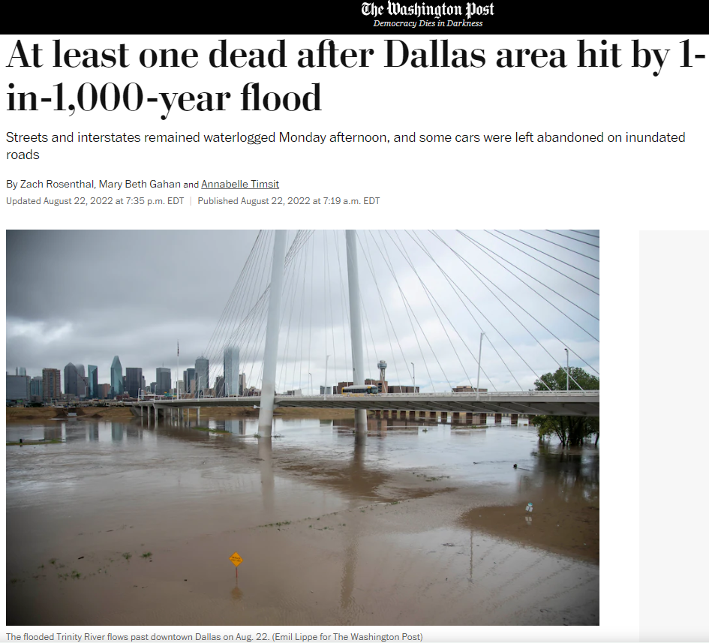

Slide 9
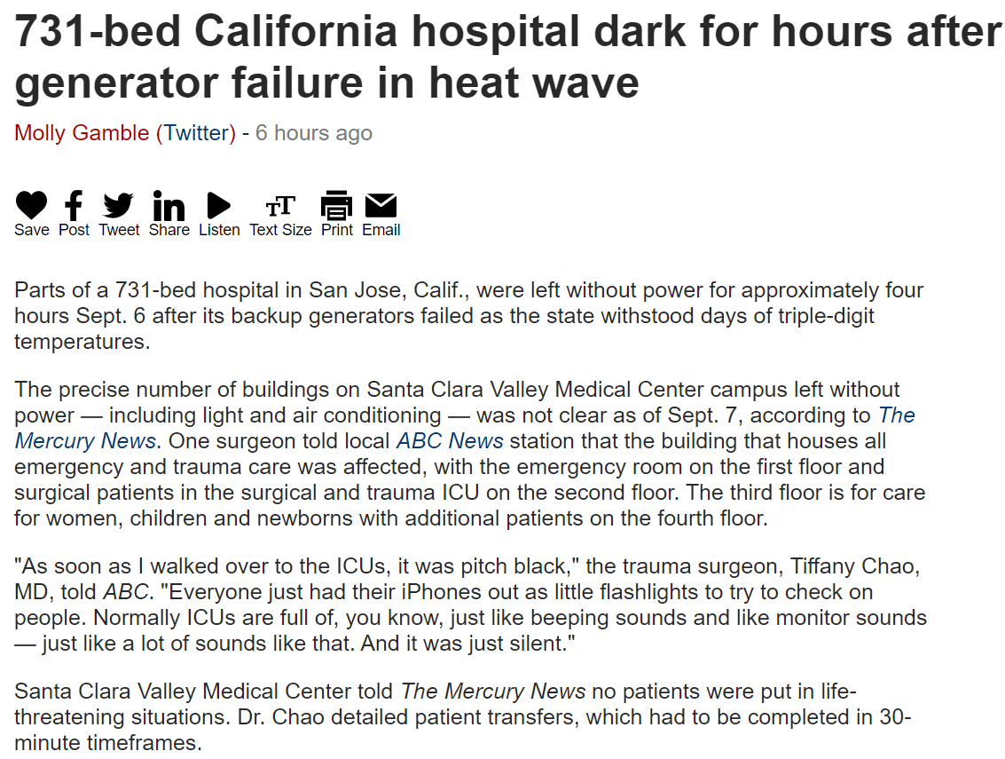

Slide 10
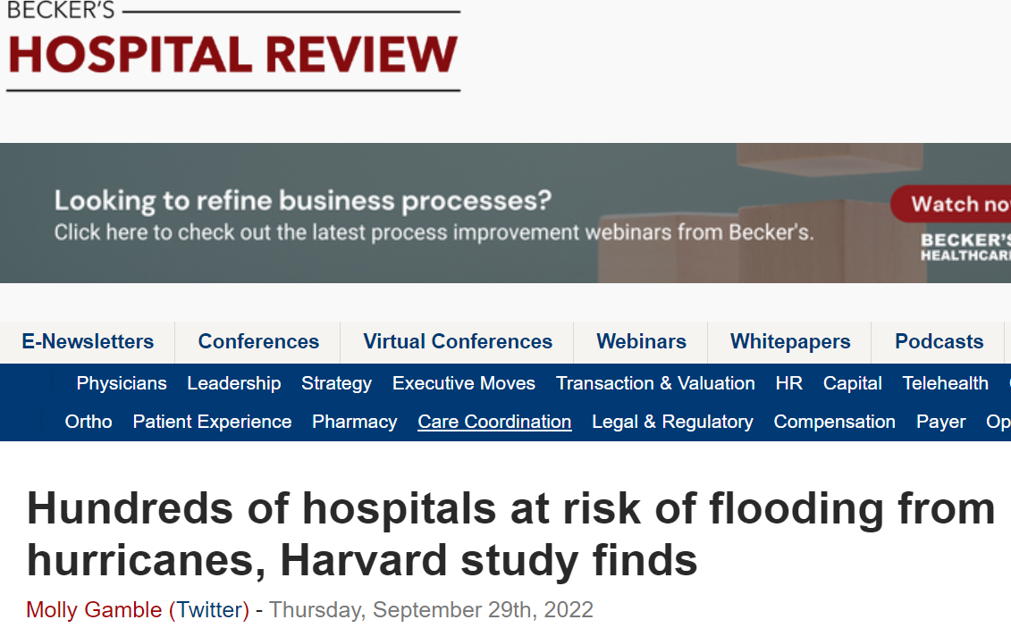
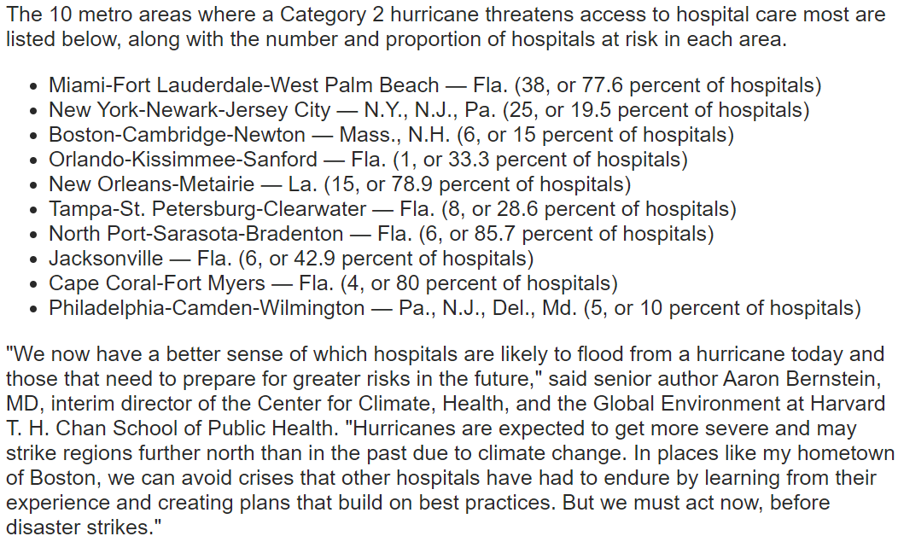

Slide 11
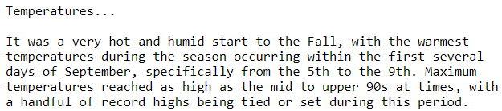




Slide 12
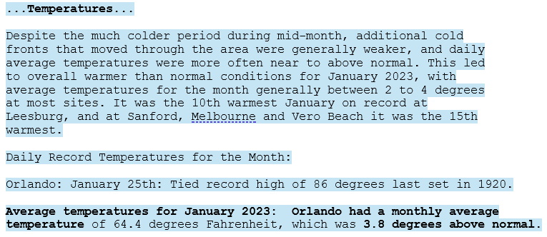

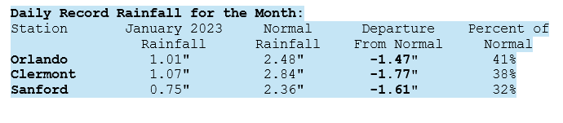

Slide 13
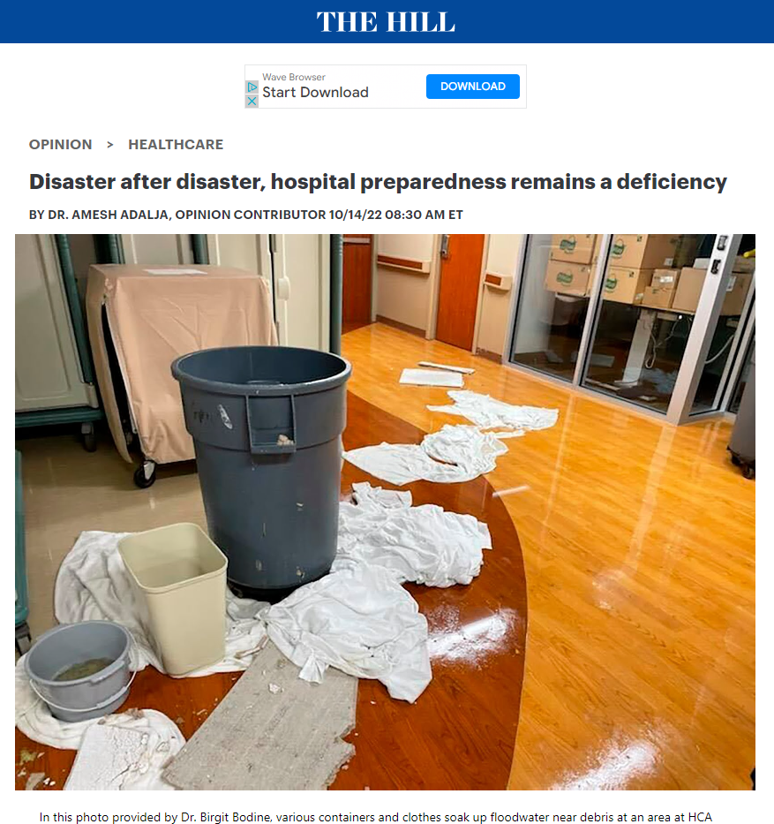
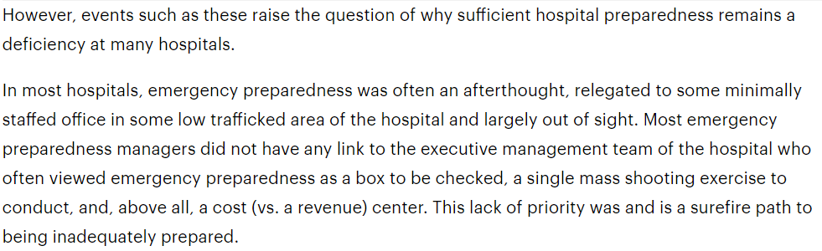
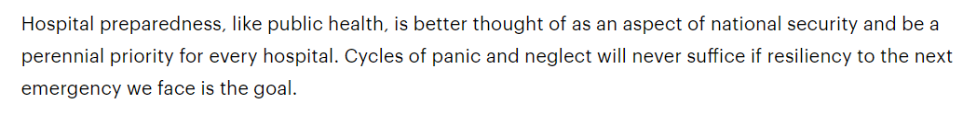

Slide 14








Frequency of Occurrence, Range of Duration, Range of Geographic Scope, Intensity for each of the below will increase
Warmer Temperatures – Extreme Heat Waves [Global Warming]
Last 8 years hottest record for globe
Increase temperature by 1.5°C or 2.7°F by 2030 across the globe
Intense Droughts
To become more intense
Water Scarcity
Severe Fires – Wildfires
Longer & more intense; Southeast increase to 30%
Rising Sea Levels – Saltwater Intrusion
Rise 1-8’ by 2100
Flooding – Extreme Rainfall
Melting Polar Ice
Artic may be ice free
Catastrophic Storms & Declining Biodiversity
Tropical Systems to become stronger and more intense

